Slide 1
Status of Seismic Networks in North America
Tim Côté, Canadian National Seismic Network
Jesus Perez, Mexican National Seismic Network
Tim Ahern, Seismic Network Activity in the United States
EarthCube All Hands Meeting - May 2015

Slide 2

Canada
EarthCube All Hands Meeting - May 2015

Slide 3
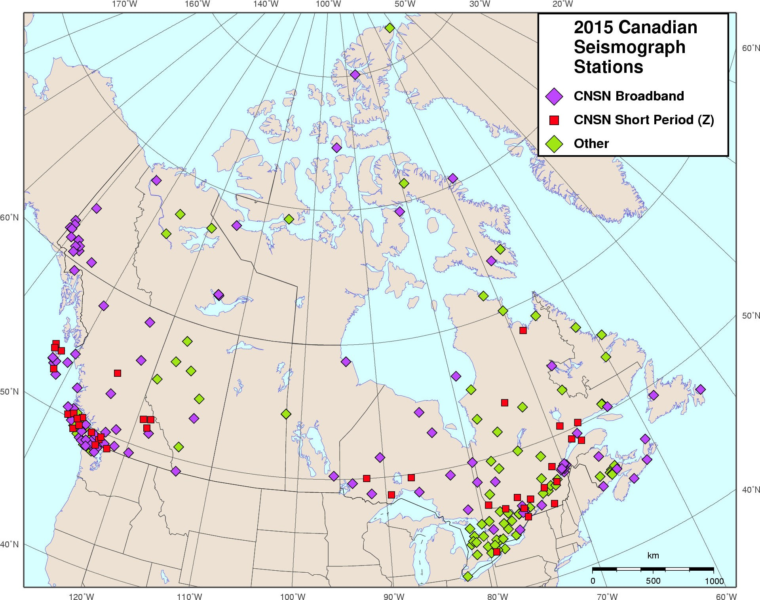
Current Status – Canadian Seismic Networks (weak motion only)
Station Equipment
Digitizers
Nanometrics
Guralp (for YKA)
in-house
Seismometers
Guralp
Nanometrics
S13

Slide 4
Current Status – Canadian Seismic Networks (weak motion only)
CN network – 180 stations, including
  136 Canadian National Seismograph Network, CNSN. Acquired by GSC
    97 broadband 3 component, 39 short period vertical
  44 Other GSC stations (i.e. research). Data acquired by GSC
    broadband 3 component
  CN median data availability for 2014 > 96%
PO network – 36 stations
  ex-POLARIS stations run by Universities. Data acquired by GSC
  broadband 3 component
  PO median data availability for 2014 > 87%
WU network – 25 stations
  Southern Ontario Seismic Network, SOSN, run by University of Western Ontario, UWO. Data acquired by UWO and forwarded to GSC.
  broadband 3 component
  WU median data availability for 2014 > 95%
Other Stations: TA (~27), NV (5), PB (7), GSN (2), AFTAC (2)

Slide 5
Current Plans – next 2-4 years
Starting 5 year project to refresh all CNSN stations
  New station equipment (i.e. sensors, digitizers, etc.) for all sites. Civil upgrades where needed.
  All weak motion stations will be 3 component broadband, no more short period vertical
  Many stations will also have 3 component strong motion sensors
  Total of about 150 CNSN stations when complete

Slide 6
Status of Data Center Activities
Migration of legacy in-house processes on Solaris to Antelope processes on Linux nearly complete
Upgrade to ApolloServer from NAQS for Nanometrics-based station data acquisition
New data dissemination services in development
Data Centre preparation and planning for CNSN refreshment including:
  More robust acquisition, processing and archiving
  Better monitoring, State-Of-Health and Quality-Control tools
  Migration to PostgreSQL database with multi-master replication
  Reduced latency for automatic earthquake notification and integration with National Alerting System (NAADS)
Support of mandated Canadian government services including Federal Geospatial Platform and Open Data Portal

Slide 7
Data Center Statistics, etc
Waveform data in archive from 1975 – 2015
  event data (early years) & continuous data (later years)
  ~23 TB total volume
  ~2.5 TB/year (all data sources)
    CN ~110 GB/month
    PO ~ 16 GB/month
    WU ~ 23 GB/month
  Waveform data dissemination services
    waveform segments via autodrm
    channel-day miniSEED files via ftp (later years only)
    FDSN web services in development
    continuous real-time data via ORB, CD and earthworm
    continuous real-time data via seedlink coming soon

Slide 8

United States
EarthCube All Hands Meeting - May 2015

Slide 9
Current Status – US Seismic Networks
ANSS Backbone
US Regional Networks
CEUSN
Transportable Array

Slide 10
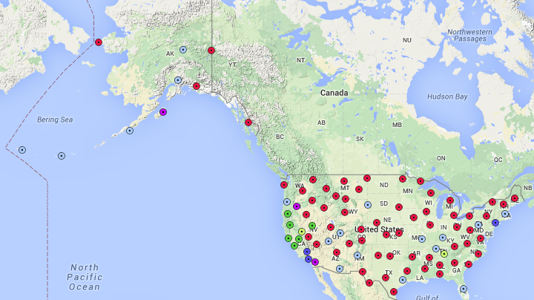
Current Status – ANSS Backbone
95 stations

Slide 11
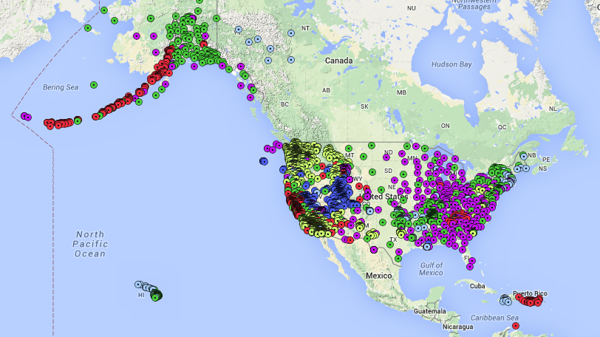
Current Status – US Regional Nets
4,301 stations

Slide 12
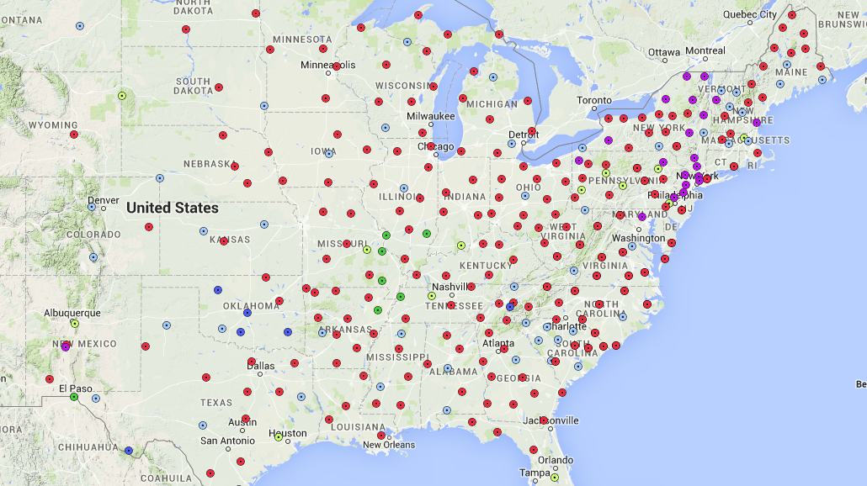
Current Status – Central and Eastern US Networks (CEUSN) 325 stations

Slide 13
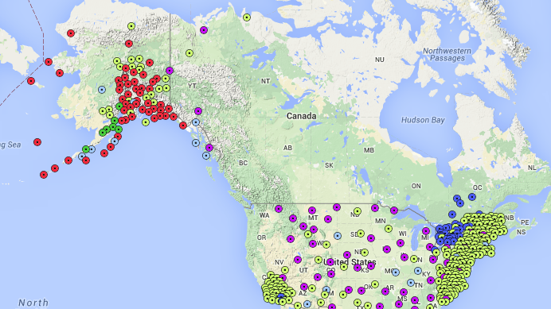
Current Status – USArray Transportable Array
433 Stations

Slide 14
Current Plans – next 2-4 years
CEUSN – funded by NSF currently and should transition to USGS operational costs in a few years.
Transportable Array – all TA stations not part of CEUSN will be decommissioned in the lower 48 states
TA is moving to Alaska

Slide 15
Status of Data Center Activities
US Seismic Network Data is managed by three entities
IRIS DMC – 44 US Networks
  206 global networks
  DMC Archive contains 333 terabytes
  Distributed 661 terabytes in 2014, projecting 974 terabytes in 2015
  Web Services in operation
  3 FDSN web services + 11 IRIS web services + 6 MUSTANG web services
NCEDC – 25 Networks
  NCEDC Archive contains 82.7 terabytes
  Distributed 17.7 terabytes in 2014
  3 FDSN web services
SCEDC – 19 Networks
  3 FDSN web services + 2 SCEDC web services
  SCEDC Archive contains 65 terabytes
  Distributed ` 20 terabytes in 2014

Slide 16

Mexico

Slide 17
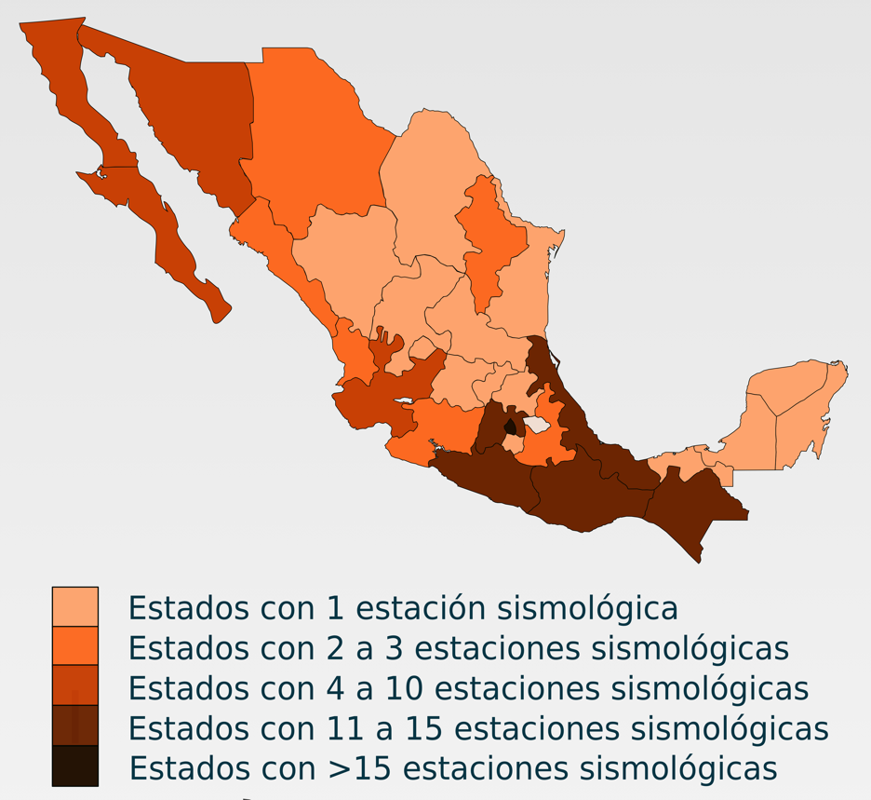
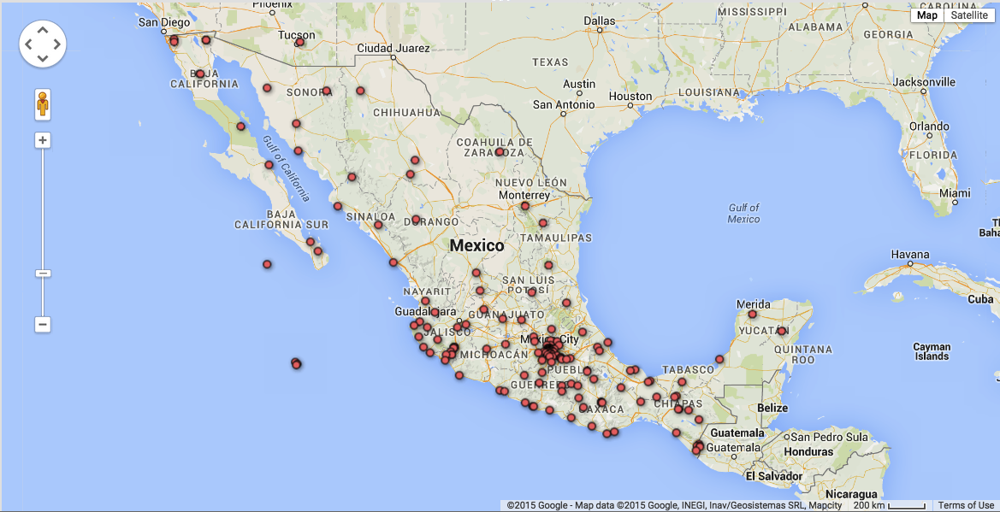
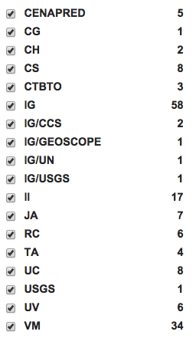
Current Status - 165 Stations with Real Time Tx capabilities - Mexican National Seismic Network
Institutions
TOTAL 165 Stations
Weak and Strong Motion
with real time Tx capabilities
maintained from different institutions

Slide 18
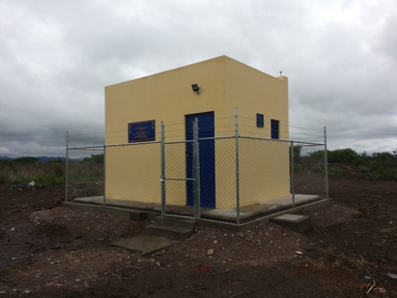
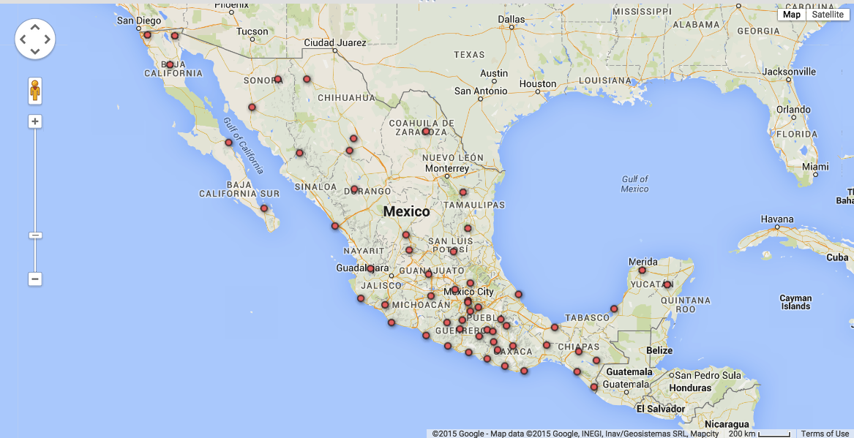
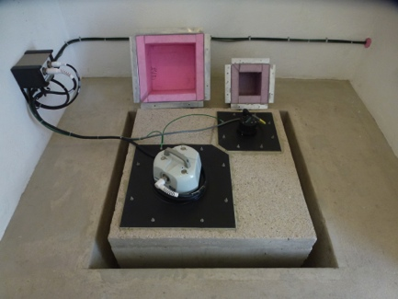
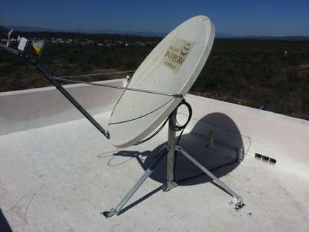
Current Status
Broadband Mexican Network at SSN
Main Monitoring Network
Maintained by Servicio Sismologico Nacional (SSN)
58 stations:
Seismic Equipment:
Quanterra, Reftek, Guralp, Nanometrics
  STS-2 &Trillium 120
  FBA-23 & EST
  18 stations with GPS Trimble NetR9 & Leica1200
  Telecommunication .
  2 Satellital Service Providers,
  Internet
  Spread Spectrum Radio

Slide 19
Current Plans – next 3 years
Starting a 3 year project to refresh all stations from the Broadband Mexican Network of the SSN, and the strong motion network of the Instituto de Ingeniería,UNAM
Install 38 new broadband stations to improve the detection capabilities in all the country, integrating in this effort regional Universities and Institutions.

Slide 20
Status of Data Center Activities
New facilities of 1,400 square meters for the SSN must be in operation by September 19, 2015, to remember 30 years of the 1985 Earthquake. Mag 8.1. Epicenter in Michoacan, Mex.
Two Oracle Netra Blade 6000 systems will be used to consolidate most of the applications required for seismic monitoring, with 6 servers Netra Sparc T5-1B and 8 servers Netra Blade X3-2B. The equipment is NEBS-3.
1 Hitachi HUS 110 with 100 TB (raw) will be used as the main storage system
A Fortigate 600 will be used as the main firewall for the SSN network
A FortiADC will be in operation to improve the response of the SSN Webpage

Slide 21
Status of Data Center Activities
All active network equipment will be refreshed with Cisco switches.
A new videowall with 12 screens Planar of 55 inches will be deployed in the monitoring room.
1 250KW Emergency Generator (Caterpillar) with seismic certification will be deployed to maintain continuity of operations.
2 UPS Mitubishi working in tandem (60 KVA + 40 KVA) will be installed
1 Tower of 45 meters will be installed to received data from the stations in the Mexican Valley and Popocatepetl volcano
A mirror of the main facilities is planned to be deployed outside Mexico City.

