Slide 1




Updates on AfSC and Seismological Activities in Africa
Atalay Ayele &
Michelle Grobbelaar

Slide 2
African Seismological Commission (AfSC)
AfSC was established on January 22, 2014 in Johannesburg, South Africa
Current Office bearers:
Current progress:
President:Atalay Ayele (Ethiopia)
1st Vice President: Bekoa Ateba (Cameroon)
2nd Vice President: Ahmed Hosny Ali (Egypt)
Secretary: Michelle Grobbelaar (South Africa)
Representative: Paulina Amponsah (Ghana )
the website
the first general assembly (we now have two bids, one from Zimbabwe and another from Egypt)
- scientific program for the general assembly is in progress

Slide 3
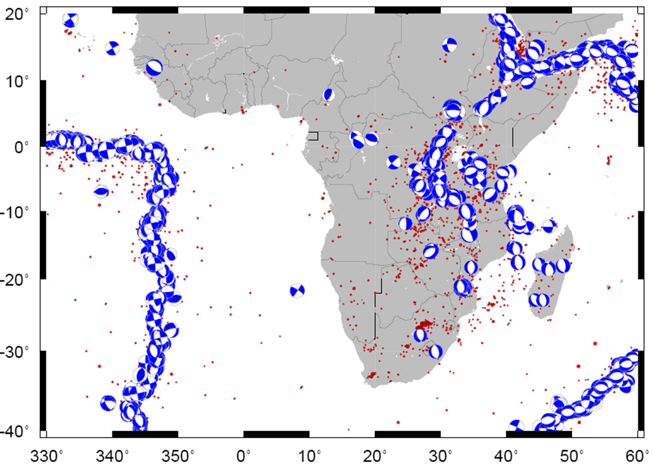
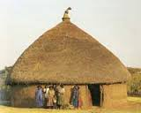
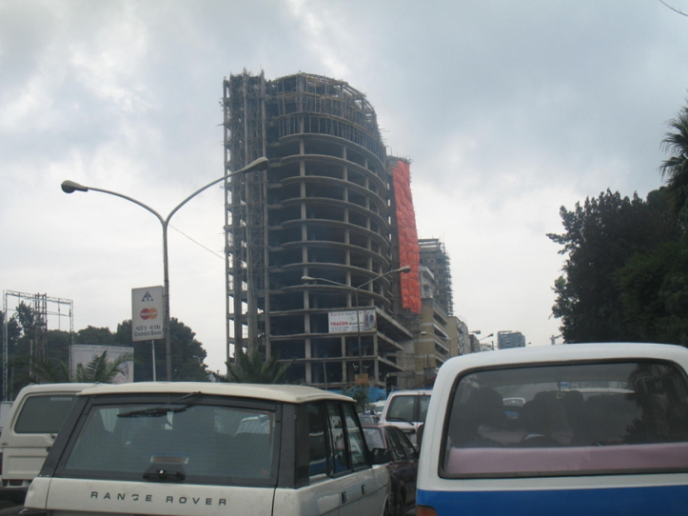
Justifications
EARS

Slide 4
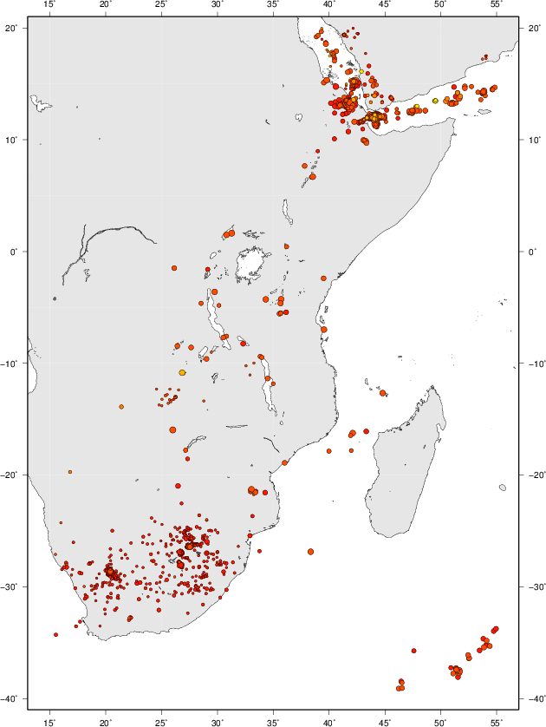
ISC 2011 catalogue

Slide 5
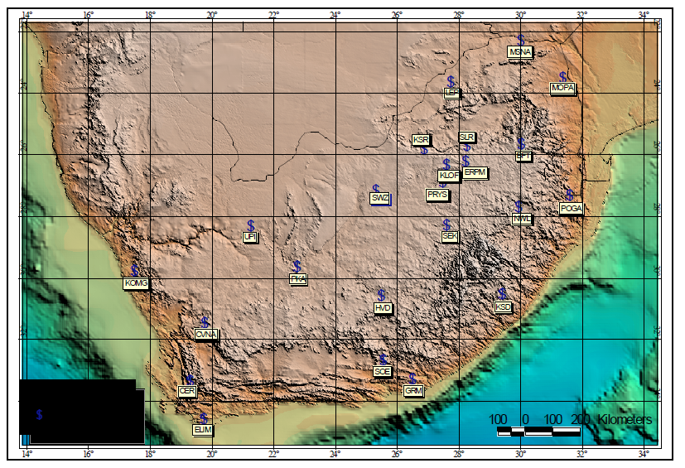
South Africa Seismic Network
Saunders, 2007 (FDSN report
There are also seismological activities in Botswana, Namibia and Angola

Slide 6
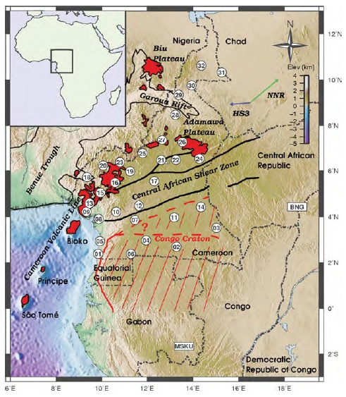
Cameroon Volcanic line
Koch et al., 2011
A lot of seismological activities in Cameroon, Nigeria, Ghana, Senegal etc

Slide 7
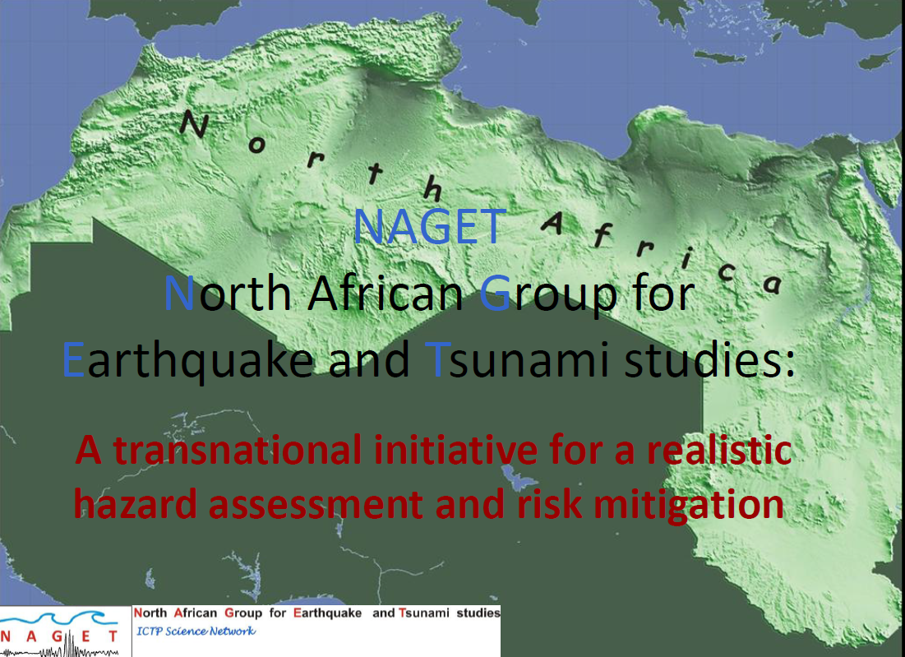
North African Group for Earthquake & Tsunami studies (NAGET)

Slide 8
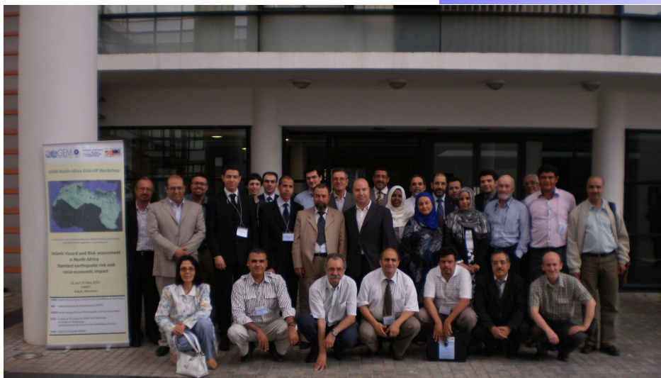
North Africa Seismological Community
North Africa GEM workshop in Rabat , 2011

Slide 9
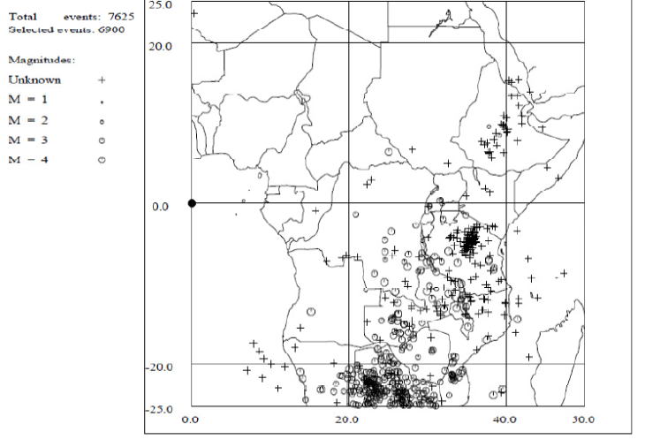
ESARSWG (Eastern and Southern Africa Seismological working Group)
(supported by ISP since 1993)
Eritrea
Ethiopia
Kenya
Malawi
Mozambique
Tanzania
Zambia
Mozambique

Slide 10
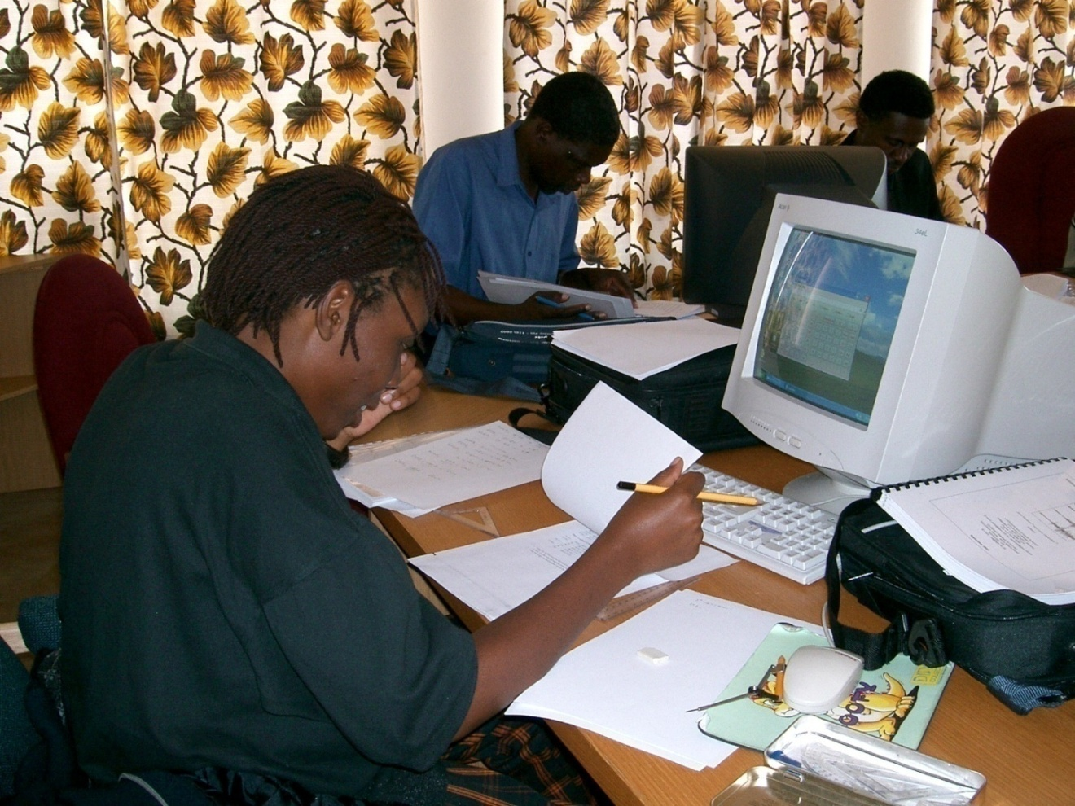
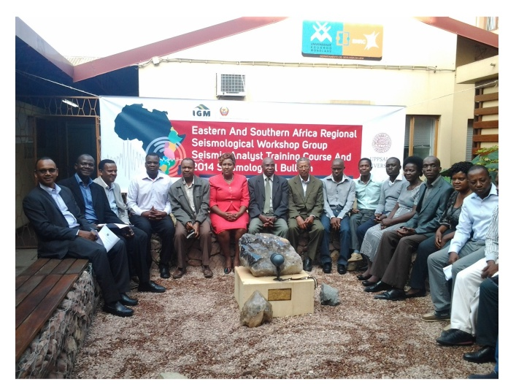
ESARSWG capacity building
Analyst workshop in Bulawayo (Zimbabwe), 2005
Mozambique bulletin workshop, May 11-16, 2015 held in Maputo

Slide 11
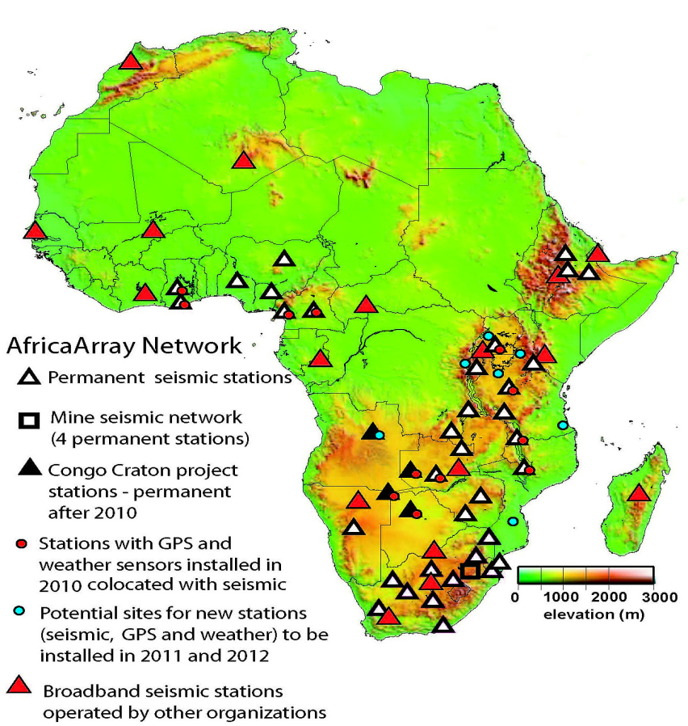
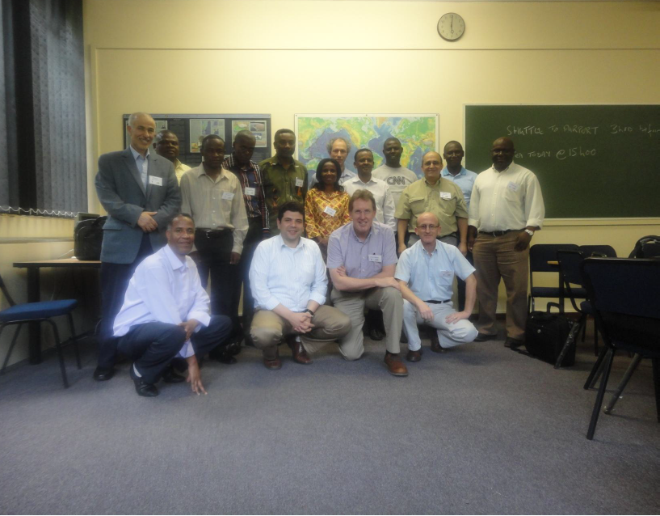
Regional collaborations
More on resource sharing and PG training
Supported AfSC meetings

Slide 12
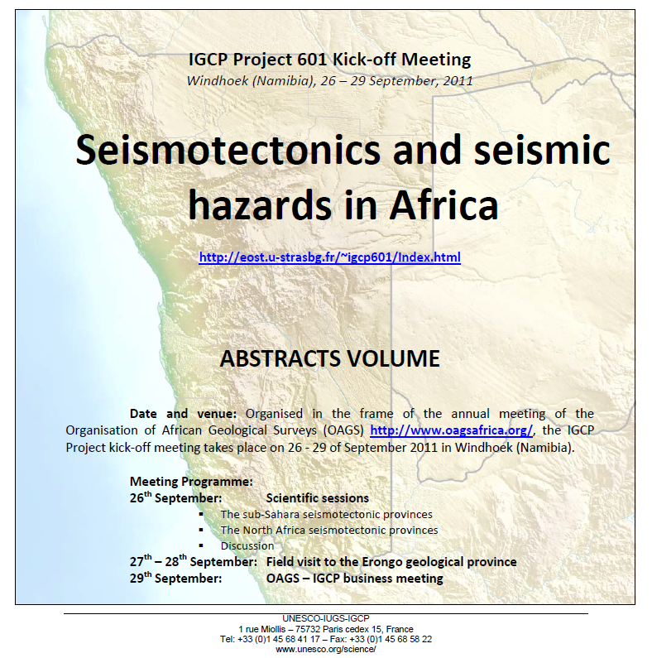
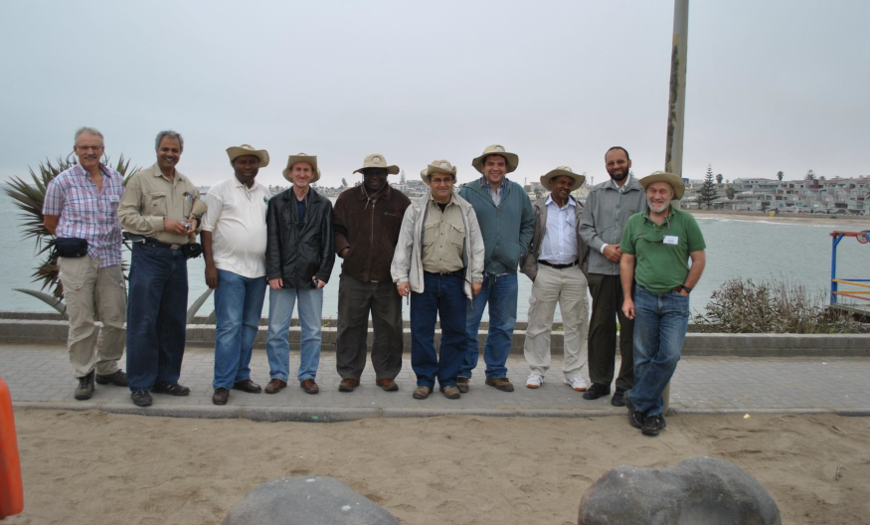
Regional collaborations

Slide 13
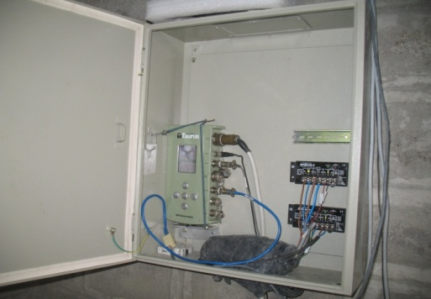
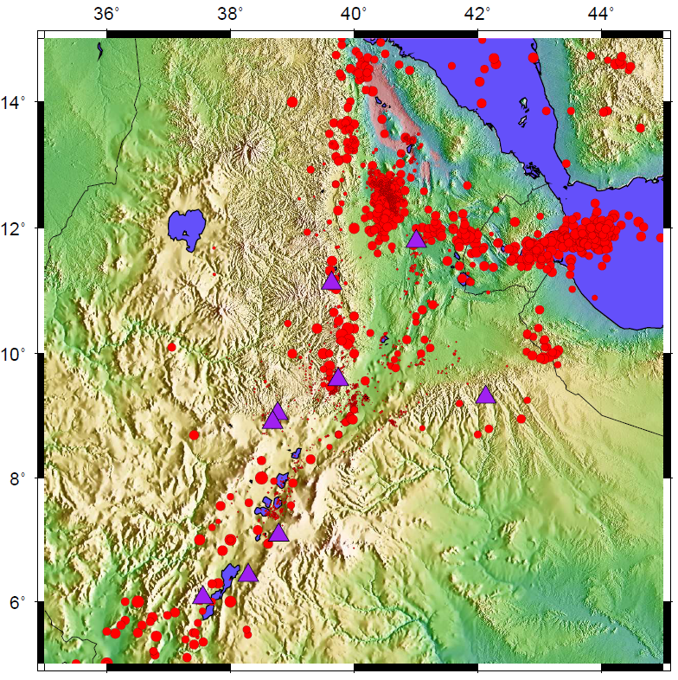
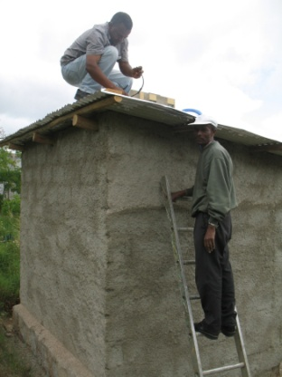
Ethiopian Seismic Station Network (ESSN)
The purple triangles are the locations of the nine seismic stations running in Ethiopia
DESE
SEME
ANKE
HARA
AAE
FURI
COFE
ARBA
DILA

Slide 14
Details of the seismic station network in Ethiopia
No. | Stat. code | Sensor | Digitizer | Period | affiliation | status
1 | AAE | CMG-3T | RT130 | 100 sec | AA + ESSN | working
2 | ANKE | Trillium co. | RT130 | 120 sec | AA+ ESSN | working
3 | ARBA | CMG-3ESP | Taurus | 60 sec | ESSN | Vandalized
4 | COFE | Le-3d/5sec | RefT. DAS | 5 sec | ESSN | Working
5 | DESE | Le-3d/20 sec | RT130 | 20 sec | AA + ESSN | working
6 | DILA | Trillium co. | Taurus | 120 sec | ESSN | working
7 | FURI | STS1, STS2 | Q330 | 350, 120 sec | USGS/CTBT | working
8 | HARA | CMG-3ESP | Taurus | 60 sec | ESSN | working
9 | SEME | Trillium co. | Taurus | 120 sec | ESSN | working

Slide 15
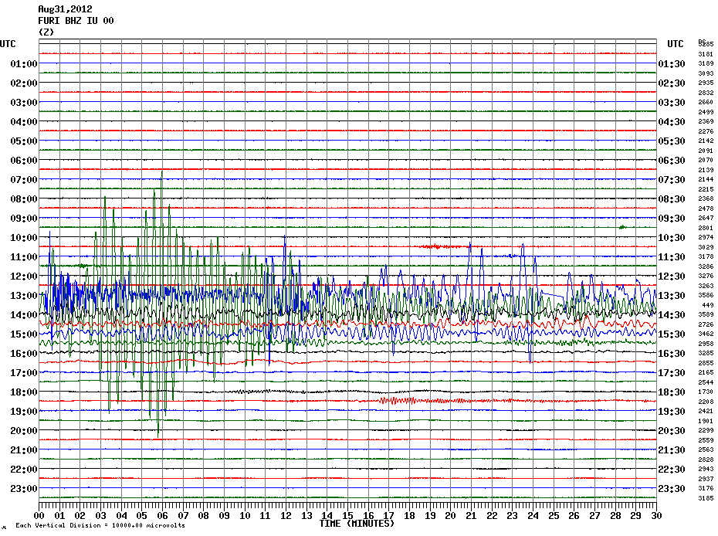
Access for real-time data
FURI
AAE
DESE
HARA
ATD
KMBO
With the help of Richard Luckett (BGS)
Notes:
15

Slide 16
Conclusions
There is tremendous seismological activity in Africa but not coordinated enough
Number of experts is improving
Number & quality of Seismic stations are improving

Slide 17
Challenges
- Maintenance of facilities and lack of local funding
- Data archiving
- Lack of real-time data and unable to maintain standard Seismological Practice

Slide 18
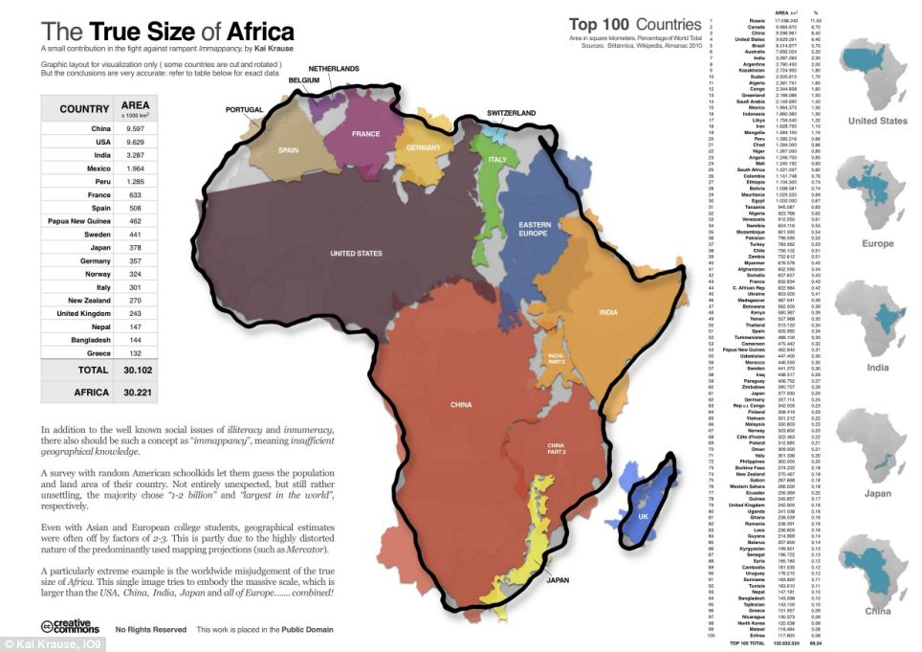
After 2/3 of the earth covered by ocean

