Slide 1
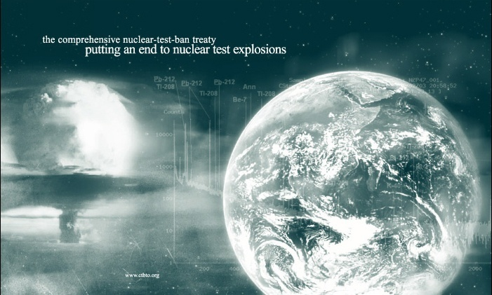
The International Monitoring System:
status and challenges
David Jepsen, Coordinator
International Monitoring System Division
Preparatory Commission for the Comprehensive Nuclear-Test-Ban Treaty Organization
Vienna International Centre
P.O. Box 1200
A-1400 Vienna
AUSTRIA
david.jepsen@ctbto.org

Slide 2
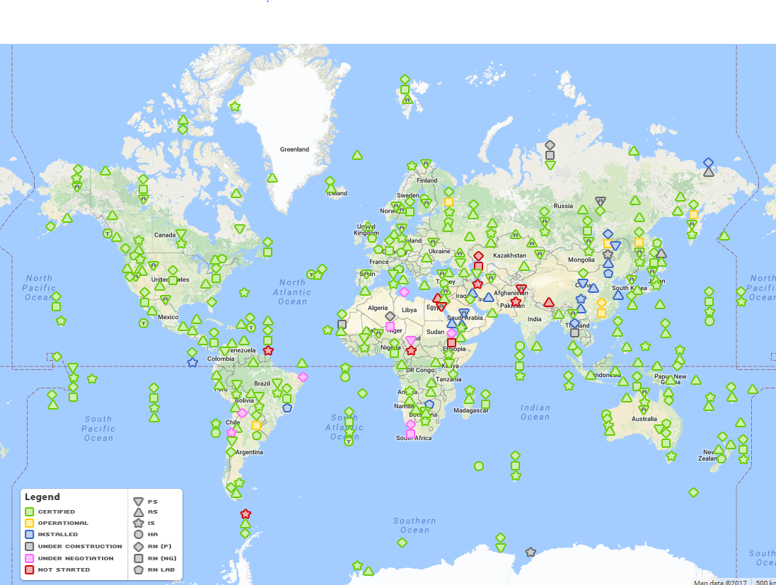
IMS – Current status
IMS status
292 stations, 31 NG systems, 16 RN labs
in situ

Slide 3
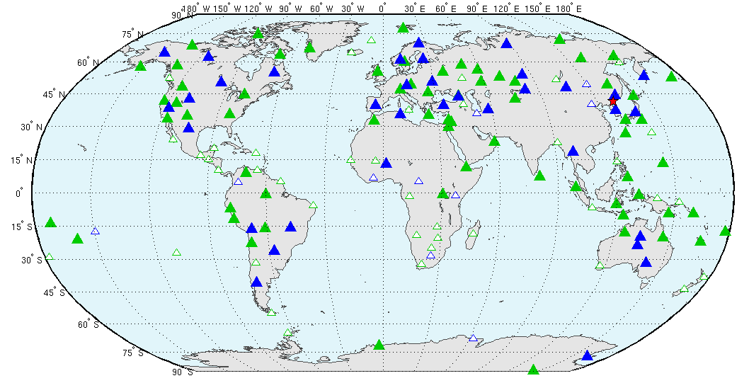
Capable IMS – DPRK4
Primary associated
detections
Primary no detection
Auxiliary associated
detections
Auxiliary not used
Notes:
IMS Primary and auxiliary seismic stations used in interactive review
83 stations used in seismic solution

Slide 4
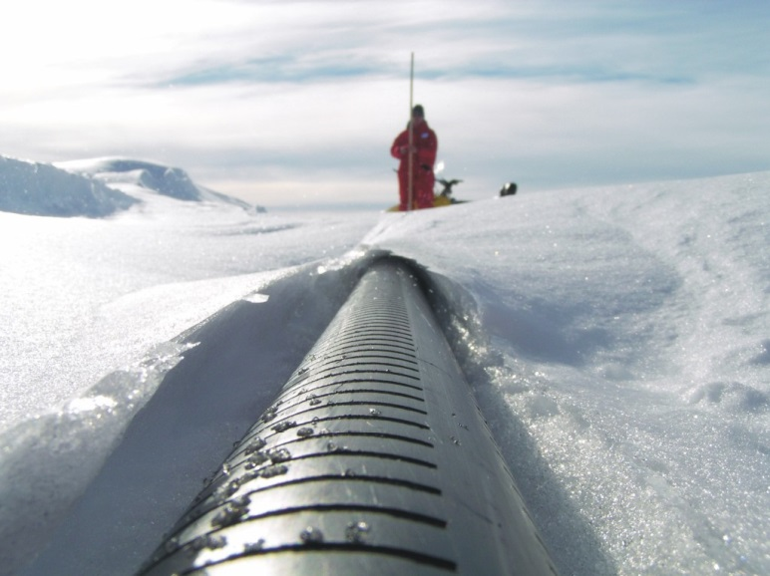
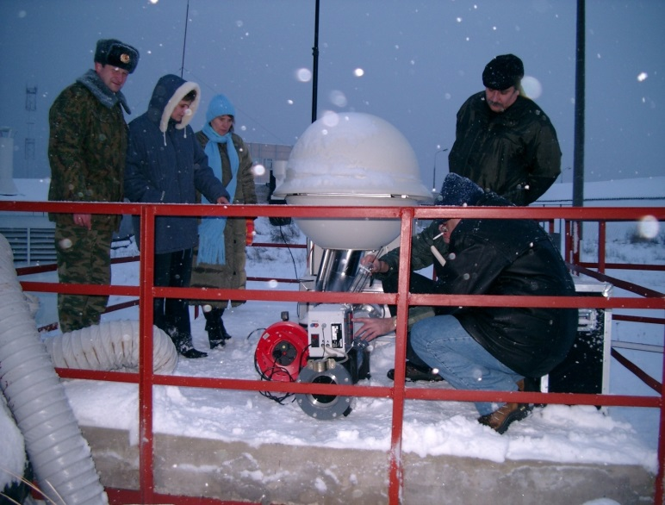
Challenge 1: completing installation and certification of remaining facilities
Political barriers
Challenging environments
Environmental regulations
Expense
IS27 Georg von Neumayer, Antarctica
RN61 Dubna

Slide 5
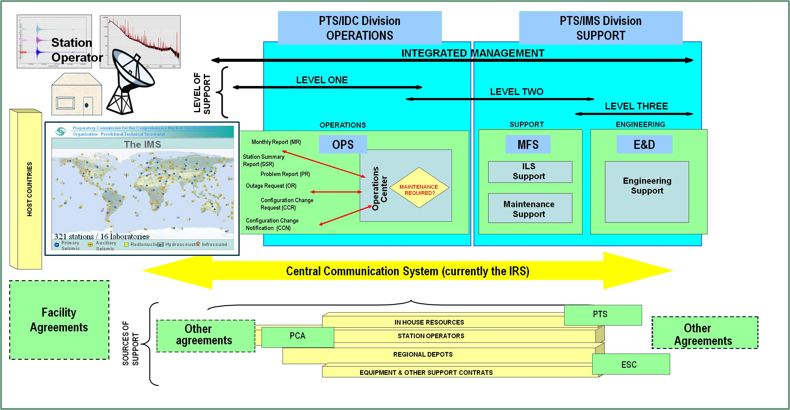
IMS Sustainment – Sources of Support
Challenge 2: IMS Sustainment

Slide 6
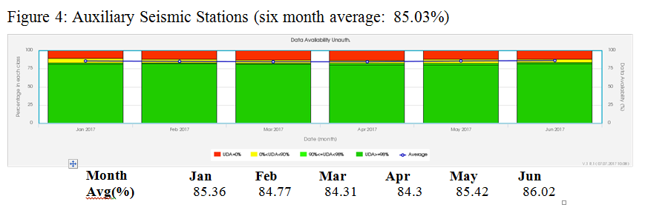
Auxiliary seismic stations – Data Availability
Serious issue that needs to be addressed
CTBTO will to continue to work with wider community on this issue

Slide 7
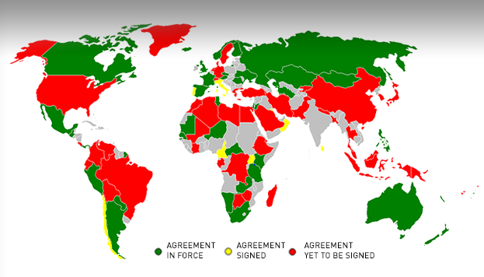
Facility Agreements
Total of 89 States to host stations – 49 facility agreements signed

Slide 8
Challenge 3: Continuous Improvement
Treaty Relevant Data
  Calibrated
  Meets sensitivity/capability requirements
Reliable and cost-effective IMS
  Makes best use of technological advances and develops engineering solutions to:
    Enhance sensitivity/capability of stations/network
    Reduce cost of station construction and ongoing maintenance
    Enhance data quality
    Increase station uptime
    Extend station life

Slide 9
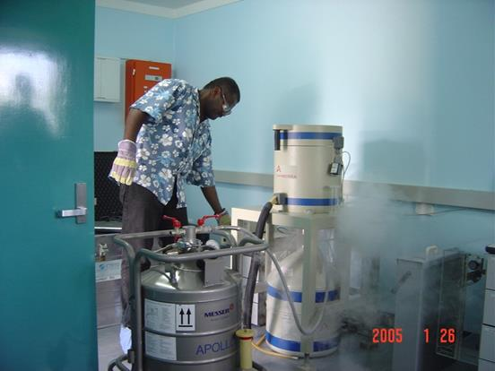
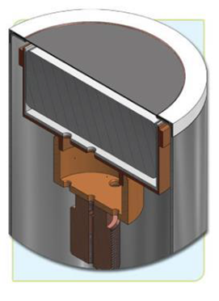
Hardening of stations/equipment
Improvement of power supply and grounding at stations:
  Fundamental issue across the IMS
  Poor quality of power is the major root cause for RN station failures
Continued improvement of HPGe detector reliability:
  > Testing of new hardened detectors
HPGe detector

Slide 10
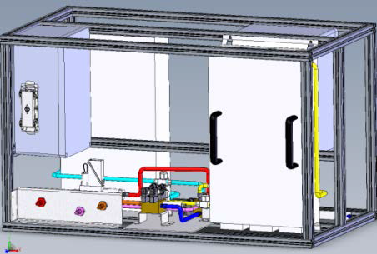
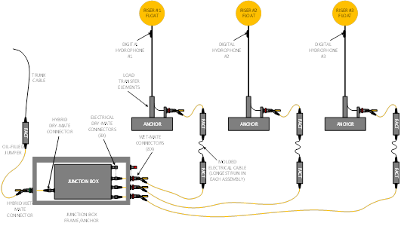
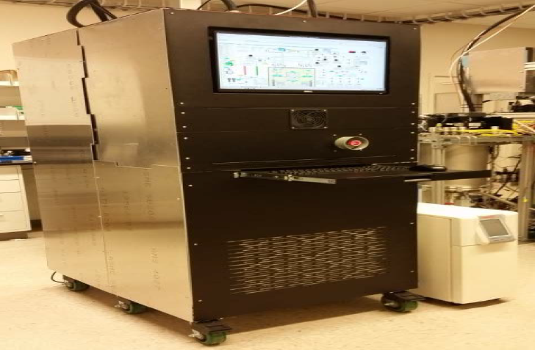
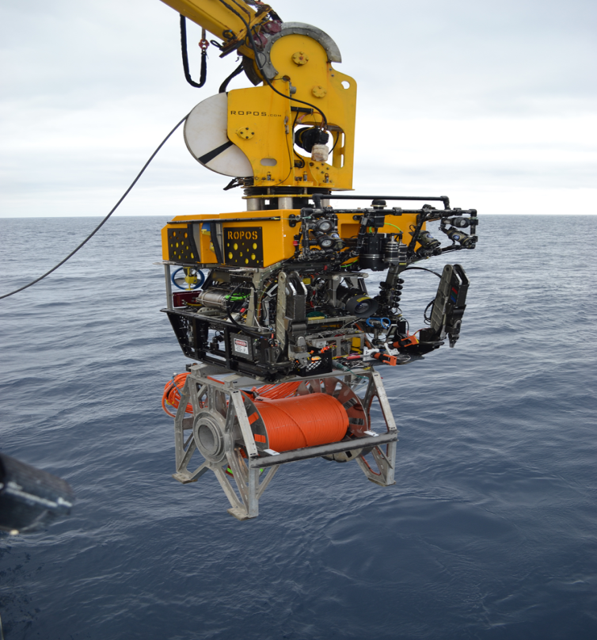
Examples of New Engineering developments
Next Generation
Noble-gas Systems
Developments on Modular Hydroacoustic Hydrophone Systems

Slide 11
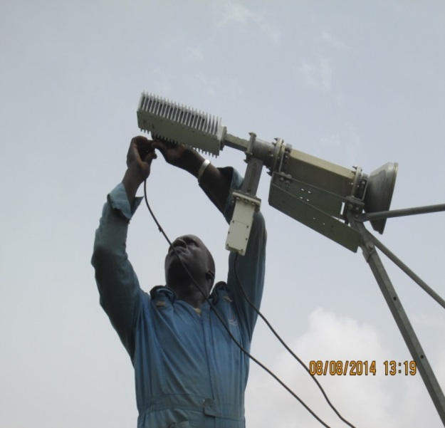
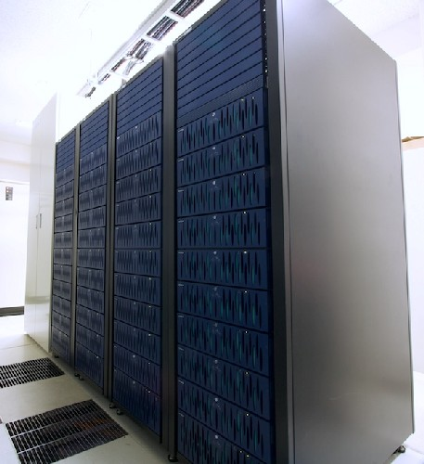
Challenge 4: data available and secure
Functional Global Communications Infrastructure
Robust information technology infrastructure
PKI integration and rollout

Slide 12
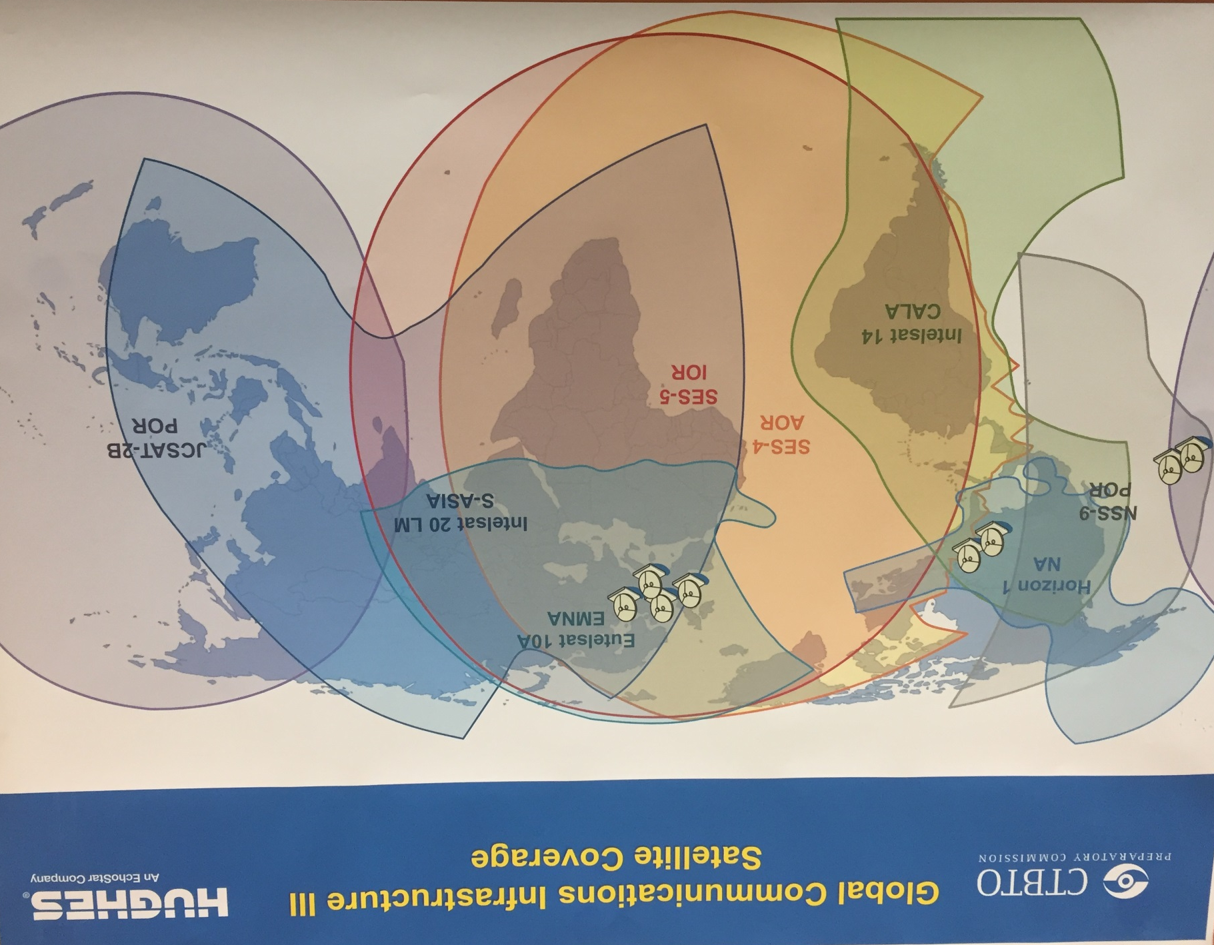
Transition to GCI-III
- implementation Nov 2016–Jun 2017
- your co-operation is essential
- increased bandwith
- redundacy

Slide 13

virtual Data Exploitation Centre (vDEC for Scientists)
Since 2011 vDEC became a component of CTBT’s strategy to engage and exchange knowledge with the scientific community.
A project funded by the EU
        vDEC makes IMS data and IDC products available
  How to get a cost-free contract:
  Scientific organizations must submit a proposal to gain access to the data
  Specify for what purpose(s) the data are needed and provide a description of the scientific research project.
  For further info, email: vdec@ctbto.org.
  Online submission of request: https://www.ctbto.org/specials/vdec/

Slide 14
Summary
  IMS 91% complete
  IMS is operationally ready
  IMS has a proven capability
  Ongoing challenges
      Completion
      Sustainment
      technologically advanced
      Security of data
Page 14

Slide 15
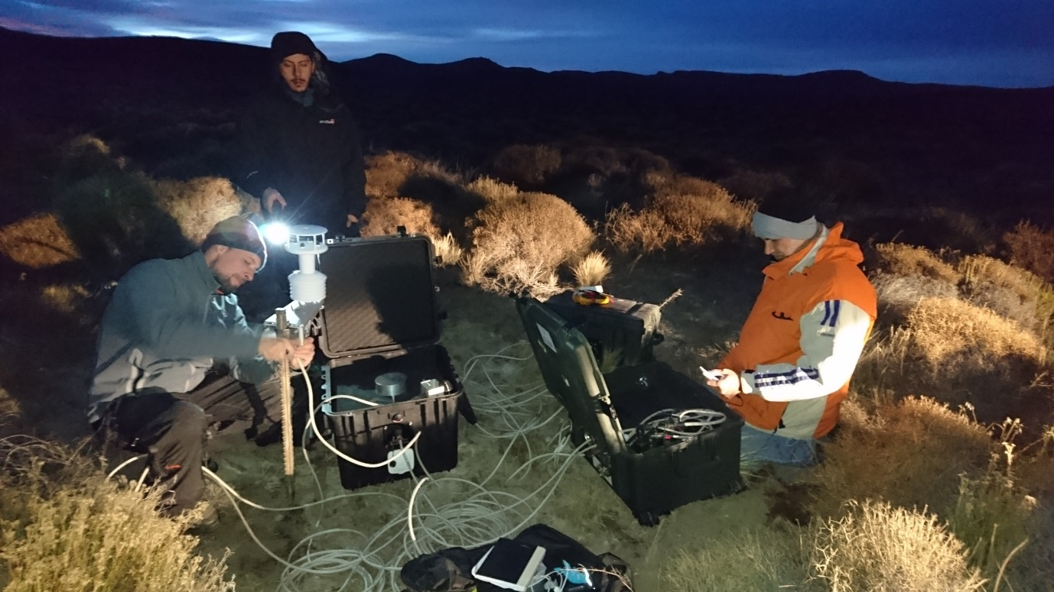
Thank you !
IS01 Argentina – site survey
IS43 (RF)
RN19 Chile, Noble Gas system upgraded in 2015

