Slide 1
FDSN Working Group III Coordination of Products, Tools and Services
IUGG Melbourne
3 July 2011

Slide 2
Proposed Agenda
Approval of 2009 WG Minutes
Revise WG III Charge
Needed Services for the FDSN
Overview of some existing efforts
ORFEUS, EMSC, ETH, Australia, IRIS
Potential for Federated Data Centers
Setting/adopting XML standards for FDSN services
Products
Existing Products
Needed Products
Tools
Tools with wide use within the FDSN
Other tools that are needed
Other Business
Additions to the Agenda

Slide 3
Approval of Minutes of 2009 WG III Minutes
http://www.fdsn.org/wgIII/2009/2009_FDSN_WGIII_minutes_draft.pdf

Slide 4
WG III Charge Modification
FDSN Working Group III
Coordination of Products, Tools and Services
Drafted July 2007
Approved January 2009
Existing Charge
FDSN WGIII will identify standard products that may be produced by FDSN data centers. WGIII will advocate product uniformity and methods of production for FDSN products. WG III will advocate development and distribution of standard software tools that will support the production of FDSN products. WGIII will propose methods of product discovery by a user and methods of product distribution.

Slide 5
Proposed Expanded Charge for WG III
Proposed New Wording for WG III charge.
Within the FDSN, WG III
Will coordinate the production of standard products and the methods for producing these products,
Will coordinate the identification, development and/or distribution of standard software applications used to acquire, manage, distribute, and use data from FDSN data centers,
Will coordinate the development and adoption of standards for services, including web services and other data center services, that are supported and deployed at FDSN centers.

Slide 6
Proposed Agenda
Approval of 2009 WG Minutes
Revise WG III Charge
Needed Services for the FDSN
Overview of some existing efforts
ORFEUS, EMSC, ETH, Australia, IRIS
Potential for Federated Data Centers
Setting/adopting XML standards for FDSN services
Products
Existing Products
Needed Products
Tools
Tools with wide use within the FDSN
Other tools that are needed
Other Business
Additions to the Agenda

Slide 7
Existing Services within the FDSN
ORFEUS and EMSC Reinoud Sleeman
ETH & QuakeML John Clinton
Australia Tim Barton
IRIS Services Tim Ahern

Slide 8
ORFEUS and EMSC Reinoud Sleeman

Slide 9
QuakeML John Clinton

Slide 10
Geosciences Australia Tim Barton

Slide 11
IRIS Efforts in Web services Tim Ahern
http://www.iris.edu/ws
Documentation of services
Parameter definitions and usage
schema definitions
URL builders
Existing Primary Web Services
Station
Dataselect
Bulkdataselet
Available
Event
Existing Secondary Web Services
Resp
Sacpz
Timeseries
Distaz
Ms2ascii
Plotter
Tracedsp
Flynnengdahl

Slide 12
Web Services Clients
Browsers
GNU wget
cURL
Java and other object oriented applications
John West ASU, Chuck Ammon Penn State, Philip Crotwell USC
PERL
FetchBulkData
FetchMetadata
FetchResp
FetchSACPZ

Slide 13
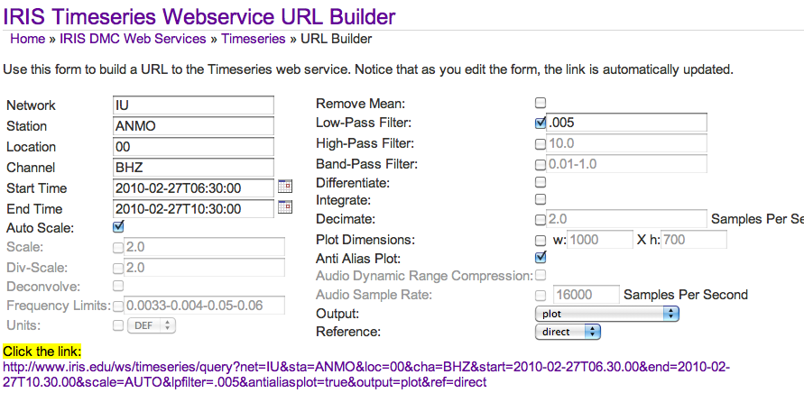
Example of Timeseries

Slide 14
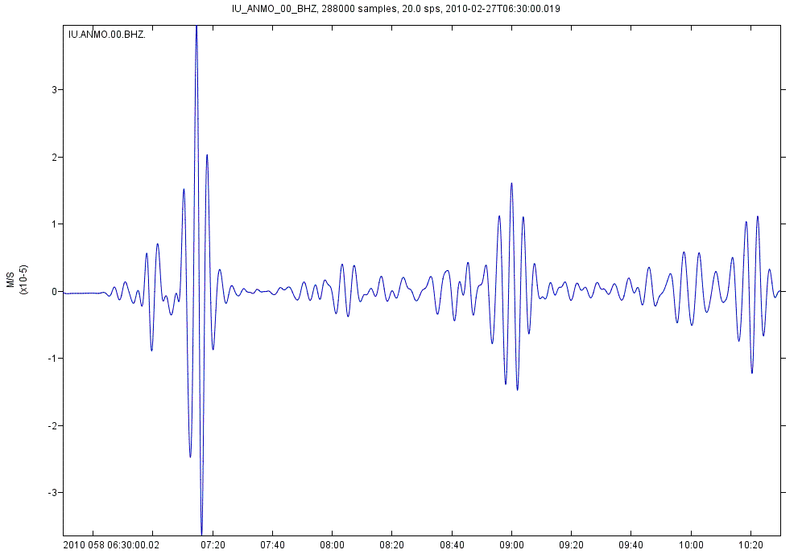
and the result

Slide 15
FetchBulkData Example
FetchBulkData
-N _GSN -L 00 -C 'BH*'
-s 2011-01-01,00:00:00 -e 2011-01-09,23:59:59
-o /Users/timahern/ws-clients/my.mseed
-m /Users/timahern/ws-clients/my.metadata
mseed2sac my.mseed –m my.metadata
Metadata inserted
Supports
Virtual Networks
* wildcarding

Slide 16
Web services
Getting started in next year or two
5 key services at FDSN data centers
Station
Dataselect
Bulkdataselet
Available
Event
How can it evolve? A Strawman Proposal
Work closely with WG II
Begin with StationXML
StationXML to Dataless exists
Dataless to StationXML exists
Over next two years combine needed metadata representations and create FDSNStationXML
InventoryXML, StationXML, ORFEUS_XML, etc.
Ability to add things such as sensor, serial numbers, digitizers (Johannes!)

Slide 17
Proposed Agenda
Approval of 2009 WG Minutes
Revise WG III Charge
Needed Services for the FDSN
Overview of some existing efforts
ORFEUS, EMSC, ETH, Australia, IRIS
Potential for Federated Data Centers
Setting/adopting XML standards for FDSN services
Products
Existing Products
Needed Products
Tools
Tools with wide use within the FDSN
Other tools that are needed
Other Business
Additions to the Agenda

Slide 18
Advantages of Standard Services
Web Services
available
Client Applications
jWeed
VASE
SOD
EMM
Emerald
Data Center Services
Breqfast
NetDC
autoDRM
WebRequest
WILBER III
metadata
dataselect
bulk
dataselect
events

Slide 19
FDSN Federated Data Centers
Client Applications
jWeed
VASE
SOD
EMM
Emerald
Data Center Servicee
Breqfast
NetDC
Webrequest
autoDRM
WILBER III

Slide 20
FDSN Data Brokering
Client Applications
jWeed
VASE
SOD
EMM
Emerald
Data Center Applications
Breqfast
NetDC
Webrequest
autoDRM
WILBER III
Registry
Broker
Data Cleaning operations
Could take place in this model

Slide 21
Proposed Agenda
Approval of 2009 WG Minutes
Revise WG III Charge
Needed Services for the FDSN
Overview of some existing efforts
ORFEUS, EMSC, ETH, Australia, IRIS
Potential for Federated Data Centers
Setting/adopting XML standards for FDSN services
Products
Existing Products
Needed Products
Tools
Tools with wide use within the FDSN
Other tools that are needed
Other Business
Additions to the Agenda

Slide 22
Products at IRIS
Products Overview
http://www.iris.edu/dms/products/
SPUD - Product Management System
http://www.iris.edu/spud/
Current Products
Ground Motion Vizualizations
Event Plots
EARS – Automated Receiver functions
PDF/PSD Bulk Data Delivery
Event Bulletins
Magnetotelluric Transfer Functions
GCMTs
Phase Picks
Data Shipment Metrics

Slide 23
Data Shipment Metrics From WG II

Slide 24
CrunchInterface
Address Bytes Gigabytes Percent
SeedLink 1304806999040 1215.2 GB 73.6 %
Custom 422858385408 393.818 GB 23.9 %
dhi-IRIS_Server 20622161304 19.2059 GB 1.2 %
WILBER 14909997056 13.886 GB 0.8 %
dhi-PondServer 4514450143 4.20441 GB 0.2 %
dhi-BudServer 3073148610 2.86209 GB 0.2 %
Wiggles 453364496 0.422229 GB 0.0 %
DMC_AUTODRM 345184603 0.321478 GB 0.0 %
timeseries 151827986 0.141401 GB 0.0 %
dataselect 126520320 0.117831 GB 0.0 %

Slide 25
Crunch Country (Total of 75)
Country Bytes Gigabytes Percent
US 383172707593 356.857 GB 21.6 %
DE 160696267943 149.66 GB 9.1 %
TW 73991309713 68.9098 GB 4.2 %
PH 73138878565 68.1159 GB 4.1 %
ES 66796378112 62.209 GB 3.8 %
PF 64300467002 59.8845 GB 3.6 %
IR 62742784512 58.4338 GB 3.5 %
CN 62650798954 58.3481 GB 3.5 %
FI 55286259712 51.4893 GB 3.1 %
MV 48497913344 45.1672 GB 2.7 %
GB 38660254983 36.0052 GB 2.2 %
MX 35807215516 33.3481 GB 2.0 %
BR 30568860410 28.4695 GB 1.7 %
PA 29292857856 27.2811 GB 1.6 %
NZ 28023619840 26.099 GB 1.6 %
FR 25564328628 23.8086 GB 1.4 %
IL 24074163200 22.4208 GB 1.4 %
NL 22809107456 21.2426 GB 1.3 %

Slide 26
Crunch Address
Address Bytes Gigabytes Percent
vsnl.net.in 96924574208 90.268 GB 5.5 %
stead@lanl.gov 76069108736 70.8449 GB 4.3 %
guoyp@cea-igp.ac.cn,tvluk@gsras.ru 67783769088 63.1286 GB 3.8 %
140.109.81.40 65416451584 60.9238 GB 3.7 %
koper@seis.utah.edu 65077494784 60.6081 GB 3.7 %
dyn.mana.pf 64300467002 59.8845 GB 3.6 %
80.66.177.193 62709127168 58.4024 GB 3.5 %
sec24-dynip-216.gfz-potsdam.de 56309740032 52.4425 GB 3.2 %
202.90.128.72 55304996864 51.5068 GB 3.1 %
seismo.helsinki.fi 55286259712 51.4893 GB 3.1 %
ifg.uni-kiel.de 50985453056 47.4839 GB 2.9 %
istar.ugr.es 50061922816 46.6238 GB 2.8 %
lsdepts.ucsb.edu 48735089152 45.3881 GB 2.8 %
202.21.178.205 48497913344 45.1672 GB 2.7 %
sec21c121.gfz-potsdam.de 40299294720 37.5316 GB 2.3 %

Slide 27
Products in Development
Synthetic Seismograms
CIG 1D and 3D Synthetics from Tromp @ Princeton
Earth Model Collaboration
Tomographic models standardized in netCDF format
Visualization tools
GEON IDV
GMT based viewer
Open Earth Framework from SDSC
World Wide Telescope
GPS Displacement-grams
Source Time Functions
Back Projections

Slide 28
Proposed Agenda
Approval of 2009 WG Minutes
Revise WG III Charge
Needed Services for the FDSN
Overview of some existing efforts
ORFEUS, EMSC, ETH, Australia, IRIS
Potential for Federated Data Centers
Setting/adopting XML standards for FDSN services
Products
Existing Products
Needed Products
Tools
Tools with wide use within the FDSN
Other tools that are needed
Other Business
Additions to the Agenda

Slide 29
FDSN Tools
Current SEED support
rdseed, verseed
Future depreciation of rdseed
Jrdseed
Libmseed
SeisComp 3
ObsPy
SAC
Widely distributed under an IRIS license
MATLAB
Forming a Matlab User’s Group
Excel for non-seismologist access
PDCC
New version in development simplifying network definition
Providing a view for non-SEED experts while retaining current capabilities
Draws on the IRIS Nominal Response Library (NRL)
The PQLX Question!!!

Slide 30
Proposed Agenda
Approval of 2009 WG Minutes
Revise WG III Charge
Needed Services for the FDSN
Overview of some existing efforts
ORFEUS, EMSC, ETH, Australia, IRIS
Potential for Federated Data Centers
Setting/adopting XML standards for FDSN services
Products
Existing Products
Needed Products
Tools
Tools with wide use within the FDSN
Other tools that are needed
Other Business
Additions to the Agenda
FDSN Endorsement of Event Description portion of QuakeML

