Slide 1
quakeML Philipp Kaestli, Fabian Euchner, John Clinton (ETHZ) 2011 FDSN Meeting, Melbourne
flexible, extensible and modular XML representation of (and data model for) seismological data
intended to cover a broad range of fields of application in modern seismology
open community standard for data exchange, collaborative development (based on rfc’s)
umbrella schema with subpackages
Common schema of resource identifiers (i.e. referencing), basic data types, error description
Different subpackages at different level of development: basic event description, ground motion, macroseismicity, etc.
Still under development; furthest developed: basic event description (QuakeML-BED)
QuakeML-BED uses include:
seismic catalogues (CSEP), realtime parametric data exchange (SeisComP3; EMSC using QWIDS), statistical seismology (QuakePy library, opensha )
Users include:
IRIS, EMSC, ORFEUS, SC3 community, GNS NZ, SCEDC, Nanometrics,ISTI,

Slide 2
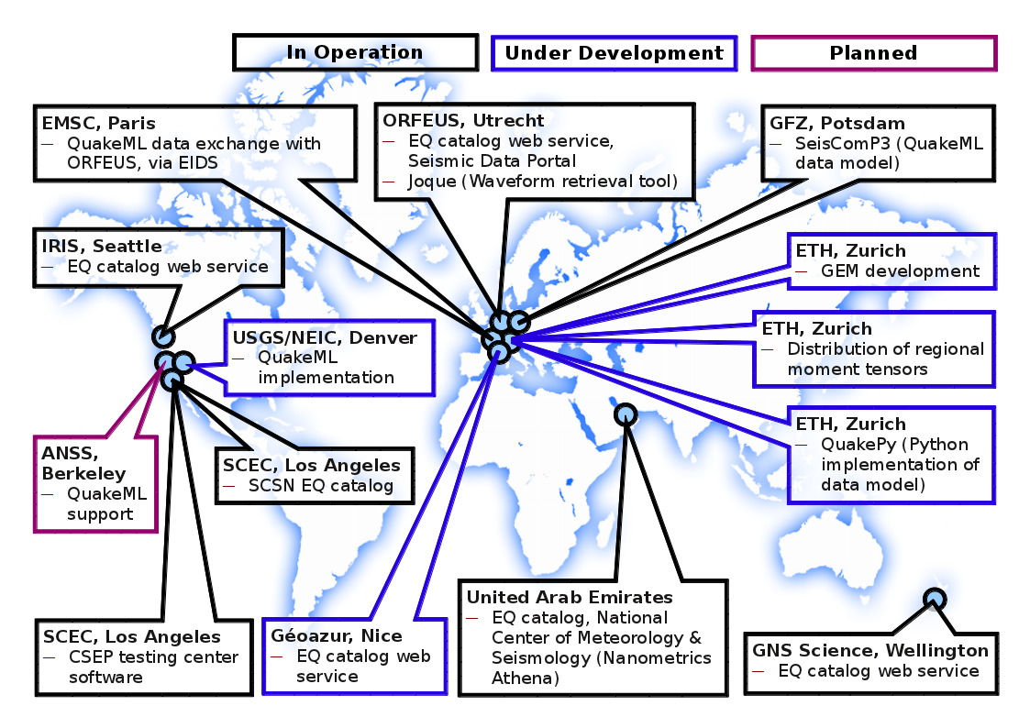

Slide 3
quakeMl development timeline
today
V1.2 release candidate
First proposed
V1.2 final release
release v1.0.1
rfc V1.0
2004
2005
2006
2007
2008
2009
2010
2011

Slide 4
quakeMl future @ ETHZ
Proposed/Active Development Areas
Station inventory (merge best of stationXML, inventory XML, add URI and uncertainty handling of quakeML)
Geophysical site descriptions
Macroseismic information (ESC working group, secretariat at ETHZ)
Ground Motion

Slide 5
quakeMl future @ ETHZ
quakeML BED widely used, de facto standard, but without official acknowledgement
quakeML funding at ETHZ prev. from NERIES
In order to consider further investments in development beyond Quakeml-BED v1.2 release:
ETHZ needs institutional backing, e.g. by FDSN adopting quakeML-BED as a standard, and consequently then
ETHZ volunteers for the role of the Secretariat moderating the community process on behalf and following the itinerary of the FDSN WGIII
ETHZ may continue to propose development steps and coordinate releases / documentation (especially inter-package coordination)
ETHZ will continue to develop components (seeking community acceptance) of direct interest

