Slide 1

Federation of Digital Broad-Band Seismograph Networks
FDSN Working Group II
Data Format and Data Centers
John Clinton (Chair)
Chad Trabant (Co-Chair)
IUGG
Montreal, Canada, 13 July 2019
1
Notes:
1

Slide 2
Federation of Digital Broad-Band Seismograph Networks
Agenda
  12:00 Review of Proposed Agenda
  12:05 Review and Approval of 2017 Meeting Summary from Kobe
  12:07 Important Announcement on WG leads
  12:10 Status of 2017 Action Items
  12:20 next generation mseed (Trabant)
  12:40 stationXML
  12:50 urn identifiers (Trabant)
  13:00 quakeMl and event types
  13:10 discussion on future strategic directions for WG2
  13:20 Other business
  13:30 Adjourn
2
Notes:
2

Slide 3
Federation of Digital Broad-Band Seismograph Networks
12:07 Important Announcement on WG leads
  Change in WG leadership
  Chair: John Clinton (ETHZ) resigns, Javier Quinteros (GFZ) nominated
  Co-Chair: Chad Trabant (IRIS) resigns, Rob Casey (IRIS) nominated
3
Notes:
3

Slide 4
Federation of Digital Broad-Band Seismograph Networks
12:10 Status of 2017 Action Items
1) Draft​ ​release​ ​1.1​ ​of​ ​StationXML​ ​with​ ​the​ ​8​ ​accepted​ ​changes​ ​and​ ​distributed​ ​to​ ​the working​ ​group​ ​for​ ​evaluation.
Responsible:​ ​Trabant
Status: release 1.1 completed in 2019 - see https://www.fdsn.org/xml/station/
​ ​​ ​​ ​​ ​
2) Compare​ ​quality​ ​metrics​ ​from​ ​common​ ​data​ ​to​ ​verify​ ​that​ ​there​ ​is​ ​consistency​ ​between the​ ​EIDA​ ​and​ ​IRIS​ ​definitions​ ​and​ ​software.
Responsible:​ ​EIDA
Status: will not do, consensus is current situation with minor differences but complete documentation is OK
​
3) Compile​ ​a​ ​list​ ​of​ ​common​ ​requirements​ ​for​ ​next​ ​generation​ ​miniSEED
Responsible:​ ​Clinton​ ​and​ ​Trabant
Status: completed in 2018 – see https://docs.google.com/document/d/1ymAe9v1rUuucpY7ai5ilKsD7V1ejwt6GxQQmJ5IevDI/edit?usp=sharing
4
Notes:
4

Slide 5
Federation of Digital Broad-Band Seismograph Networks
12:20 Next generation mini-SEED format
  Need for a new format to handle large-N experiments
  MSEED2 will remain an accepted FDSN standard
  WG2 completed Requirements for new format, including support for format conversion tools, compliance with existing FDSN standards
    Lion Krsicher (ETH) coordinated the effort
    Vote on each spec in 4/2018
    10 voters (4 N.America.; 4Europe; 2Asiana)
    (Vote not to make a requirement for real-time data transfer)
  No current candidates released to WG2
5
Notes:
5

Slide 6
IRIS-led NGF Development
IRIS NGF Development Status
Status Report
FDSN Working Group II - IUGG 2019

Slide 7
Overview
IRIS NGF Development Status
Specification is complete
Specification meets WG II requirements
Reference data set available
Library to read/write format in pre-release
Converter available
Validator available
IRIS fdsnws-dataselect delivering NGF
Next steps

Slide 8
Features: requirements and more
IRIS NGF Development Status
URN source identifier, instead of SEED codes
Increase sample rate to 64-bit precision, notation for period
Increase start time resolution to nanoseconds
Variable record length
Simplifications:
  Critical details in fixed header, fixing historical expansion
  Fixed byte order, header is little-endian, encodings are fixed
  Drop legacy data encodings, reserve values

Slide 9
Features: requirements and more
IRIS NGF Development Status
Additions:
Format version
Data publication version
CRC field, allowing validation of data integrity at any point
“Mass position off scale” flag
“Recenter” (mass, gimbal) headers
“ProvenanceURI” header
Optional headers in flexible, hierarchical key-value (JSON) structure:
Specify a reserved set of extra headers defined by the FDSN, provide schema for validation
Most previous flags and blockette contents defined in reserved extra headers
Allow arbitrary headers to be included in a record

Slide 10
Forward compatibility
IRIS NGF Development Status
Near complete preservation of miniSEED 2.4. Information that is not retained:
Clock model specification per timing exception
Blockettes 400 (Beam) & 405 (Beam Delay)
Blockette 2000 (Opaque Data)
Opaque data encoding (mostly) replaces this functionality
All other fields can be retained:
detailed mapping from version 2 -> 3 documented in specification
Legacy encodings require re-encoding

Slide 11
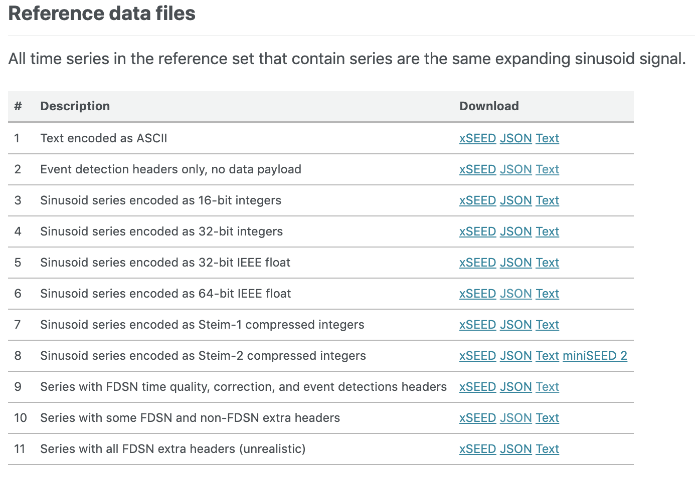
Reference data set
IRIS NGF Development Status
Useful for software development validation and illustrative examples

Slide 12
Pre-release of libmseed is ready
IRIS NGF Development Status
Available in github:
https://github.com/iris-edu/libmseed
Full read and write support for NGF
Full read and write support for miniSEED 2
Mapping from quality code to data publication version:
  R -> 1, D -> 2, Q -> 3, M -> 4
Not a drop-in replacement, but ease of porting was a focus

Slide 13
Converter available
IRIS NGF Development Status
mseedconvert:
https://github.com/iris-edu/mseedconvert
By default converts version 2 -> 3, can also convert 3 -> 2 when possible
Designed for efficient and flexible use, avoiding re-encoding when necessary

Slide 14
Format validator available
IRIS NGF Development Status
xseed-validator
https://github.com/iris-edu/xseed-utils
Includes extra header validation using JSON Schema
Project also includes xseed2json and xseed2text, used to build reference data set.

Slide 15
IRIS fdsnws-dataselect delivering NGF
IRIS NGF Development Status
The DMC’s fdsnws-dataselect service can deliver the new format when format=miniseed3
Data is converted on the fly, if needed.

Slide 16
Next steps
IRIS NGF Development Status
Prepare software ecosystem for agnostic use of either format
  Main goal: data users should not care which version they receive
Work with collaborators to smooth rough edges and verify functionality in real-world use cases
Prepare for proposal to the FDSN
Seeking collaborators for evaluation, testing, implementation!
http://iris-edu.github.io/xseed-specification

Slide 17
Federation of Digital Broad-Band Seismograph Networks
12:40 StationXML
  WG2 released a minor version update of StationXML
  (includes all accepted changes, e.g. DOI, agreed in Kobe)
  IRIS and ORFEUS currently developing documentation for StationXML
  WG2 will begin work on a major revision of StationXML related
  to future developments of mini-SEED.
  End members possible:
    fix current problems within 6 months within current XML / mseed framework
    explore how XML should change within context of new seismological needs (next-gen mseed, other formats for DAS…)

Slide 18
Federation of Digital Broad-Band Seismograph Networks
12:40 StationXML
  How to move forward?
  Immediate call for general ideas on mailing list
  Within 3 months, subgroup to review all comments and propose how to proceed.

Slide 19
Federation of Digital Broad-Band Seismograph Networks
12:50 Towards single string, URN-like identifiers for seismic stations
  IRIS proposal sent in May 2019
  Eg
  XFDSN:<network>_<station>_<location>_<band>_<source>_<position>
  Important for next gen mseed, but also for webservices, metadata defintions
19
Notes:
19

Slide 20
FDSN URN Source Identifier Scheme
IRIS Source Identifier Proposal
A Proposal
FDSN Working Group II - IUGG 2019

Slide 21
What is a URN and what does “source identifier” mean?
IRIS Source Identifier Proposal
URI: Uniform Resource Identifier
A URL, e.g. http://fdsn.org, is a URI
A URN, e.g. doi:10.7914/me2a-2978, is a URI
Source identifier:
A single string URN to uniquely identify a data/information source
An alternative to current FDSN identifiers: Network, Station, Location, Channel codes

Slide 22
The drivers for a URN scheme
IRIS Source Identifier Proposal
Next Generation Format requirement
  Working Group II requirements for a Next Generation Format stipulate a URN to identify the data source
StationXML sourceID
  Version 1.1 contains a sourceID attribute for network, station and channel
Less important, common combinations for filenames, etc.

Slide 23
Goals of our proposal
IRIS Source Identifier Proposal
Incorporate SEED codes
  Allow trivial mapping, forward and backward (when possible)
Allow for significant expansion of all codes
Focused on the form of the identifier
Make a logical first step, leave room for future steps

Slide 24
XFDSN URN scheme
IRIS Source Identifier Proposal
XFDSN:Network_Station_Location_Band_Source_Position
XFDSN = a “namespace” for this identifier scheme, room for more
Channel = Band_Source_Position (aka Band, Instrument, Orientation)
For example:
XFDSN:IU_COLA_00_B_H_Z

Slide 25
Motivation for expansion of codes
IRIS Source Identifier Proposal
Network codes can be unique, temporary network scheme is a kludge
  Reusing codes is anomaly that generates confusion and errors
  Semantically meaningless
More instruments/sensors
  Current scheme with a single letter is already allocated (for capital letters)
  Need clarity on:
    Synthetic data
    Derived data
    State of health and operational measurements
Large N in a sensible way
  Current scheme forces use of “stations” for what are reasonably nodes of an array, breaking FDSN 1km rule

Slide 26
Expansion of codes
IRIS Source Identifier Proposal
Network code: 2 -> 8 characters
Station code: 5 -> 8 characters
Location code: 2 -> 8 characters
Channel codes: 3 -> 1+ codes with separators
Station and Location codes are allowed to contain ‘-’ (dash) characters
All existing SEED codes are supported, only change is the separators for Channel
Note: code expansion is a rule for a maximum, not limited by format capability

Slide 27
Convention for temporary network deployments
IRIS Source Identifier Proposal
Network codes for deployments that are known to be temporary are strongly encouraged to include the 4-digit start year of the deployment at the end of the code with the following pattern:
<1-4 characters><4-digit start year>
For example, “SEIS2018” would be a valid network code and imply that the initial deployment was in the year 2018 and is temporary.
Suggestions for transitional mapping of previous codes, requested by operator:
<2-characters><4-digit start year>, e.g. XA operating in 2002-2003 becomes “XA2002”

Slide 28
Conclusion
IRIS Source Identifier Proposal
Fully forwards compatible (all SEED codes supported)
Backwards compatible for all current SEED codes
Significant future flexibility
Uses XFDSN namespace, more namespaces can be defined in the future
Proposal defines the form, conversation to leverage expansion can follow
Ready to be finalized and adopted
Full technical specification (sent to WG mailing list):
https://iris-edu.github.io/xseed-specification/docs/xFDSNSourceIdentifiers-DRAFT20190520.pdf

Slide 29
Federation of Digital Broad-Band Seismograph Networks
13:00 QuakeML and event types
  ETH developing plan to move from QuakeMl1.2 towards QuakeMl2.0
QuakeMl provides links between general UML data model, xml files, formal database representation. Facilitates data exchange and interoperability of software & tools.
QuakeMl1.2 is already adopted:
QuakeML Basic Event Description 1.2
-> FDSN standard
-> xml used in FDSN event services
-> database used in seiscomp3, qfeed, etc.
-> interoperable with ObsPy, QuakePy, ...
-> fully documented
29
Notes:
29

Slide 30
Federation of Digital Broad-Band Seismograph Networks
13:00 QuakeML and event types
  ETH developing plan to move from QuakeMl1.2 towards QuakeMl2.0
QuakeMl provides links between general UML data model, xml files, formal database representation. Facilitates data exchange and interoperability of software & tools.
QuakeMl2.0 may include, among others:
- QuakeML Site Characterization (1.0 draft)
- QuakeML PeakMotion (1.0 draft)
- QuakeML Basic event description 1.3 (minor revision of the current “QuakeML” = QuakeML Basic Event description RT/non-RT 1.2)
- QuakeML Macroseismic (1.0 draft)
- QuakeML Inventory = StationXML2.0
Tasks include:
One off: Documentation, Tools, Web
Continuous: Discussion management
ETH will bring a proposal for 2.0 to WG3 mailing list.
30
Notes:
30

Slide 31
Federation of Digital Broad-Band Seismograph Networks
13:00 quakeML and event types
  Long-standing requests to revise Event types in quakeMl1.2
  Various (hierarchical) proposals have been proposed (eg EMSC/NEIC/ISC, 2012), but none implemented
  Issue not only for WG2 but also COSOI
  Dmitry Storchak (ISC) has offered to lead effort across both groups
31
Notes:
31

Slide 32
Federation of Digital Broad-Band Seismograph Networks
13:10 discussion on future strategic directions for WG2
  Are we addressing the right topics?
  Overlap with WG3
  Is this WG trying to do too many different things?
32
Notes:
32

Slide 33
Federation of Digital Broad-Band Seismograph Networks
13:10 discussion on future strategic directions for WG2
  For new formats / standards, FDSN WGs should adopt a structure for each phase of Proposal, Evaluation and Adoption
33
Notes:
33

Slide 34
Federation of Digital Broad-Band Seismograph Networks
  Straw Man
  Applies to WG2 and WG3, possibly others
  2 stage process with 1/ proposal then 2/ evaluation and adoption
  min 2 months / max 6 months discussion for each stage
  Core team with at least 3(?) members from at least 2(?) regions set up for each stage, possible to change team through each stage
  At end of each stage, a vote to proceed with current plan, or on multiple plans, will be held over email
  Allows for end member scenarios: 1/ existing feature (eg webservices) or 2/ planned feature (eg next gen mseed)
  Entire process within WG mailing list. Can lead to adoption without review at biennial meeting.
34
Notes:
34

Slide 35
Federation of Digital Broad-Band Seismograph Networks
  Straw Man
  Evaluation and Adoption: Report / feature is evaluated and commented on by WG. Core team reviews comments and if the feature will be a candidate for FDSN adoption, recommendations will be made. WG vote on adoption
Existing feature
Proposal: WG leads announce potential feature. Core team formed to report on feature and suggest suitability for FDSN. WG decides whether worthwhile to continue towards adoption.
New Feature
Proposal: WG leads announce plan to develop a new feature. WG decides whether worthwhile to pursue at FDSN level. Core team formed to develop specifications and then actual feature. Core team prepare report for FDSN. WG decides whether worthwhile to continue towards adoption.
35
Notes:
35

Slide 36
Federation of Digital Broad-Band Seismograph Networks
13:20 Other business (Miscellaneous topics)
  Quality Control:
    Mature definitions of quality metrics exist @ IRIS, EIDA
    Minor differences can be expected between QC information
    propose to drop efforts to exact definitions, instead ensure metric definitions are documented.
    Handled in WG3
  Data provenance:
    No progress since Kobe
    May be somewhat included in stationXML
36
Notes:
36

Slide 37
Federation of Digital Broad-Band Seismograph Networks
13:30 Adjourn
37
Notes:
37

